Slide 1

Transport Layer
(TCP Congestion Control)
Lecture 6 | CSE421 – Computer Networks
Department of Computer Science and Engineering School of Data & Science

Slide 2
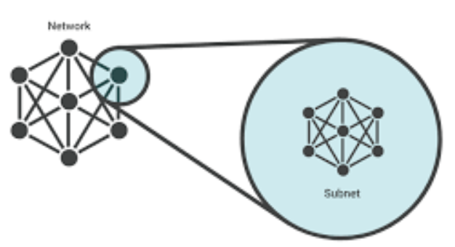
Subnet
A subnet, or subnetwork, is a logical subdivision of an IP network
Divides a large network into smaller and secure segments
How Subnet is created
Each IP address has two parts
Network and host
To create a subnet, a subnet mask is used.
This is a 32-bit number (like 255.255.255.0)
that tells a router which part of the IP address is for the network
which part is for the individual device
When devices are in the same subnet, they can communicate directly
if they are in different subnets, their data must pass through a router

Slide 3
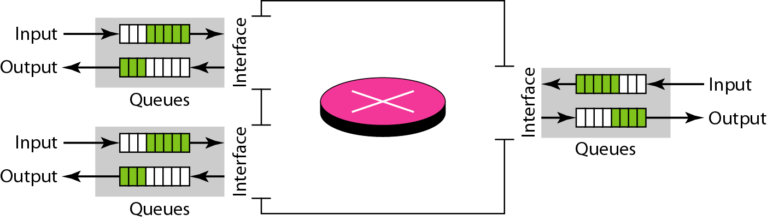
Congestion
Congestion occurs
the load on the network > the capacity of the network
the number of packets a network can handle.
the number of packets sent to the network
Store packets when arrival rate > processing rate
If the buffer fills up, new incoming packets are dropped.
Departure rate < processing rate.
If the buffer becomes full, waiting packets are dropped.
Router

Slide 4
Queues in a router
If packet arrival rate > the packet processing rate
input queues becomes longer and longer
If packet departure rate < the packet processing rate
output queues becomes longer and longer

Slide 5
Congestion
Congestion occurs at the Network Layer (within the routers)
Controlled primarily at the Transport Layer
Network Layer (the road) is where the traffic jam happens
Transport Layer (the driver) is the one who has to decide to slow down.

Slide 6
Congestion Control Vs Flow Control
Congestion control try to make sure subnet can carry oﬀered traﬃc, a global issue involving all the hosts and routers.
It can be open-loop based or involving feedback
Flow control is related to point-to-point traﬃc between given sender and receiver.
it always involves direct feedback from receiver to sender

Slide 7
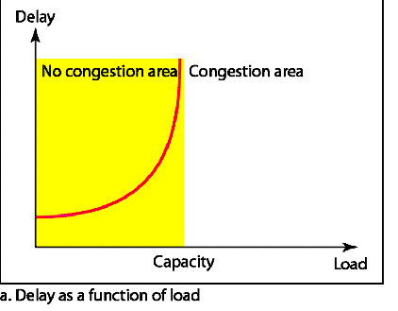
Network Performance
At the start
Load is low,
the Delay is very low and relatively flat.
As load increases
The curve stays fairly stable
Because the routers' buffers are mostly empty
can handle incoming packets immediately.
As we move closer to the Capacity line
the delay starts to curve upward.
This is because packets are starting to wait in the "Output Queues"
Delay has a negative effect on the load consequently the congestion.
Delay Occurs
The ACK can not reach the source
The ACK can not reach the source
Source retransmits
Congestion worsens.

Slide 8
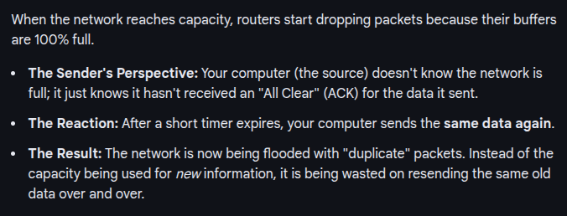
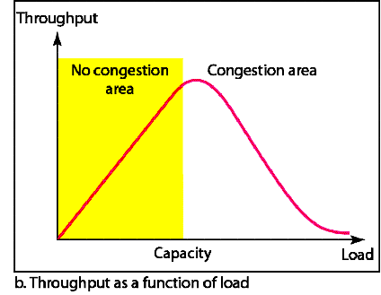
Network Performance
Why does the throughput sharply decline after the load reaches capacity instead of remaining constant?

Slide 9
Congestion Control
What is Congestion Control?
mechanisms and techniques to control the congestion
and keep the load below the capacity.
Two categories of Congestion Control
Open Loop (Prevention)
Closed Loop ( Removal)

Slide 10
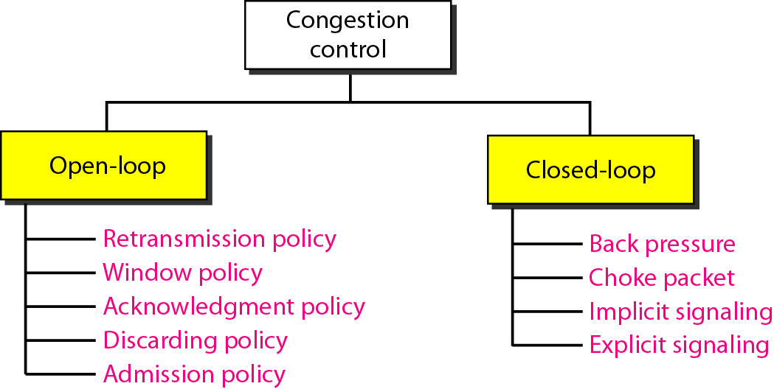
Congestion Control Categories

Slide 11
Open Loop Congestion Control

Slide 12
Open Loop Congestion Control
Proactive method
Prevent congestion from occurring in the first place
Good network design and strict rules are introduced.
They do not monitor the network's current state to make changes.

Slide 13
Open Loop Congestion Control
Retransmission /Window Policy:
Retransmission in general increases congestion. (Example-later)
Go-Back N ARQ window vs Selective Repeat window.
Acknowledgement Policy:
If a receiver sends an ACK for every single packet, it adds traffic and results in congestion.
The protocol can be designed to reduce the number of acknowledgements

Slide 14
Open Loop Congestion Control
Discarding Policy:
A good policy by routers may prevent congestion and at the same time may not harm the integrity of the transmission.
ex: Routers can choose to discard less important packets (like low-priority video data) to keep high-priority data (like routing info) moving.
Admission Policy:
Check resource requirement before sending packet.
A "gatekeeper" approach. If the network is already busy, it simply refuses to let new connections start

Slide 15
Closed Loop

Slide 16
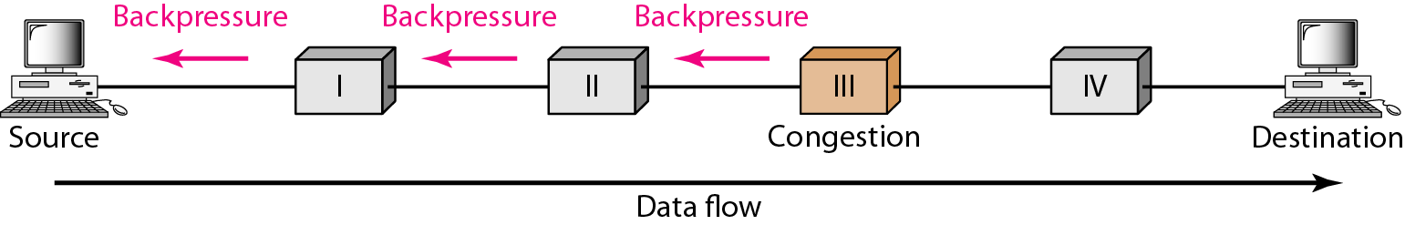
Backpressure
buffers are full, congestion
Hop by hop congestion control.
Congestion node stops receiving data from upstream nodes.
Upstream nodes may get congested, they in turn reject data from their upstream nodes.
Used in Virtual Circuits.

Slide 17
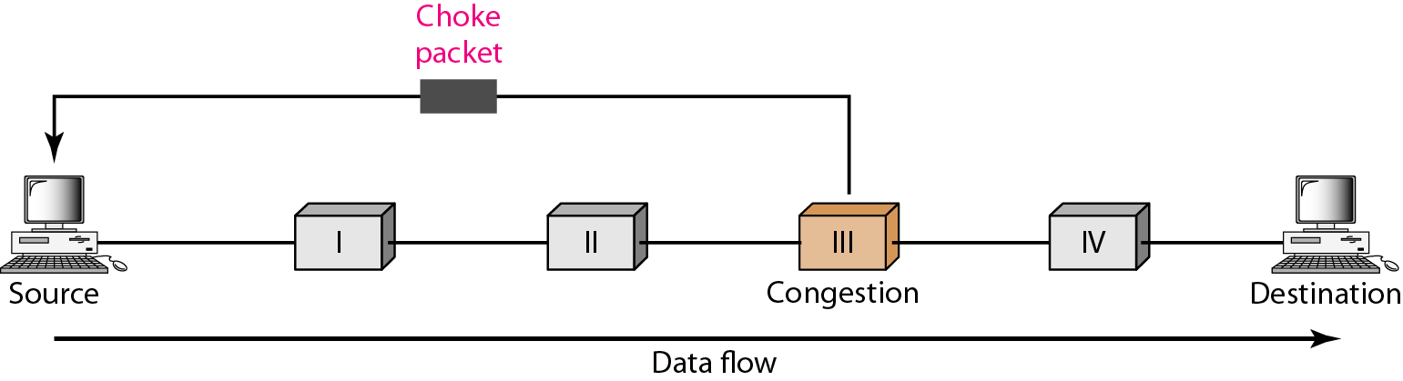
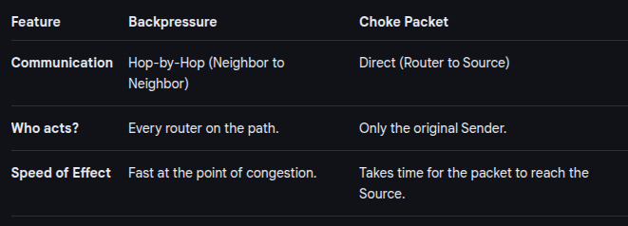
Choke packet
From a router to source directly.
Immediate nodes are not warned.
Example ICMP-source quench message. Immediate routers take no action.

Slide 18
Implicit Signaling
No communication between the congested node or nodes and the source.
Source guesses congestion by:
No acknowledgement for sent packets
If the timer runs out (Timeout) and no ACK has arrived, the sender assumes the packet was dropped.
In modern networks, the most common reason for a dropped packet is that a router's buffer was full. Therefore,
No ACK = Congestion.
Delayed acknowledgements (Increased RTT)
The sender tracks the Round Trip Time (RTT)
As routers become busy, packets sit in queues longer. If the RTT starts climbing (e.g., from 20ms to 200ms)
The sender knows the "pipes" are getting full and slows down before packets actually start dropping.

Slide 19
Explicit Signaling
The node experiencing congestion sends signal to the source.
Not a separate packet like the “choke”packet.
Signal included in the data packet itself.
Can be
Backward Signaling-Source warned, slows data
Forward Signaling-Receiver warned, slows acks.
Read more at : ECN

Slide 20
Congestion Control in TCP

Slide 21
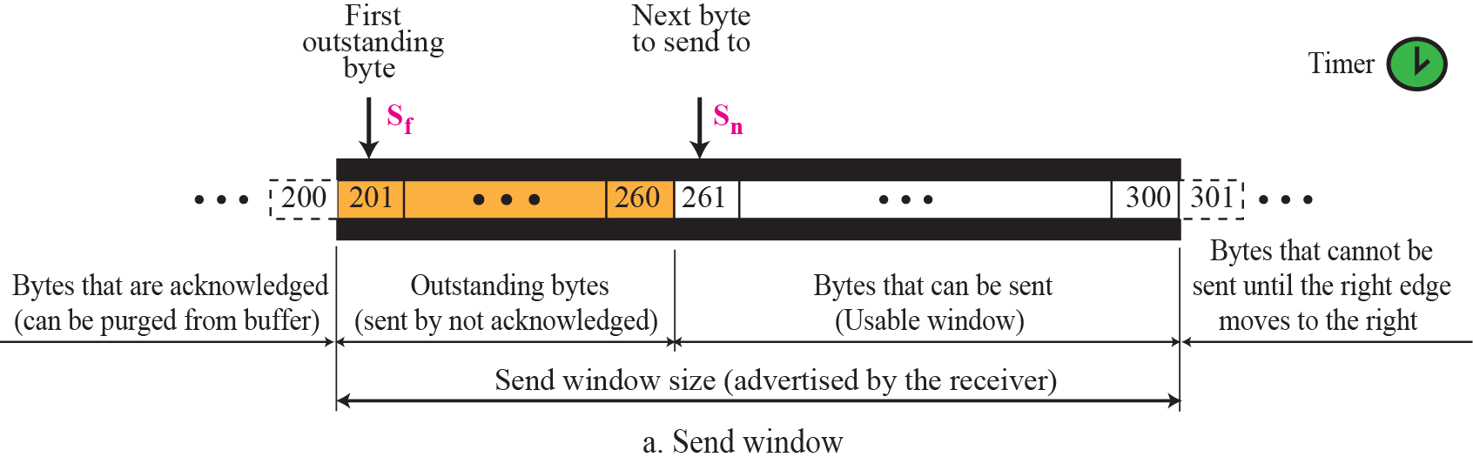
TCP Window – Sender Window (Review)
Sender Window Size is dictated by the receiver window.
Usually sender window size is determined by the available buffer space in the receiver (rwnd).

Slide 22
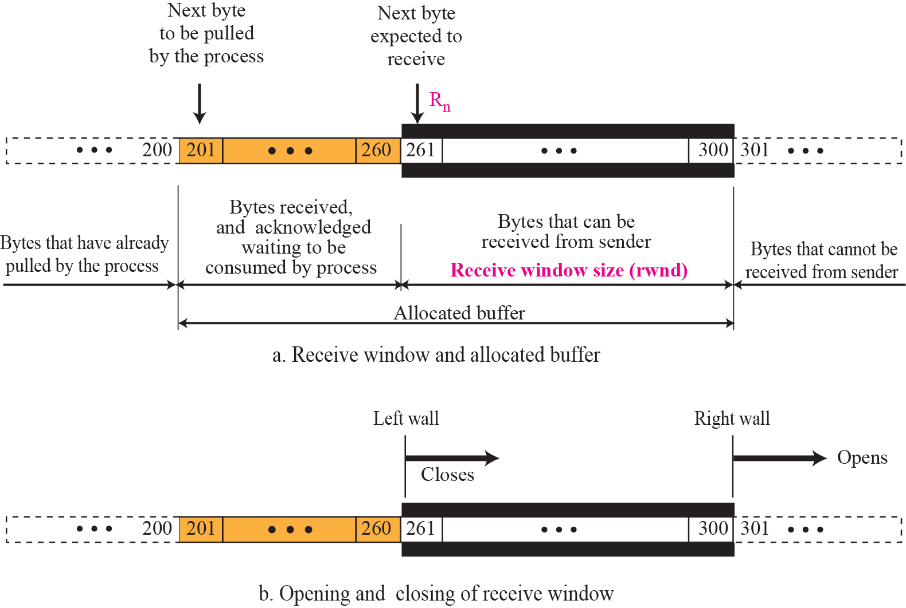
TCP Window – Receiver Window (Review)

Slide 23
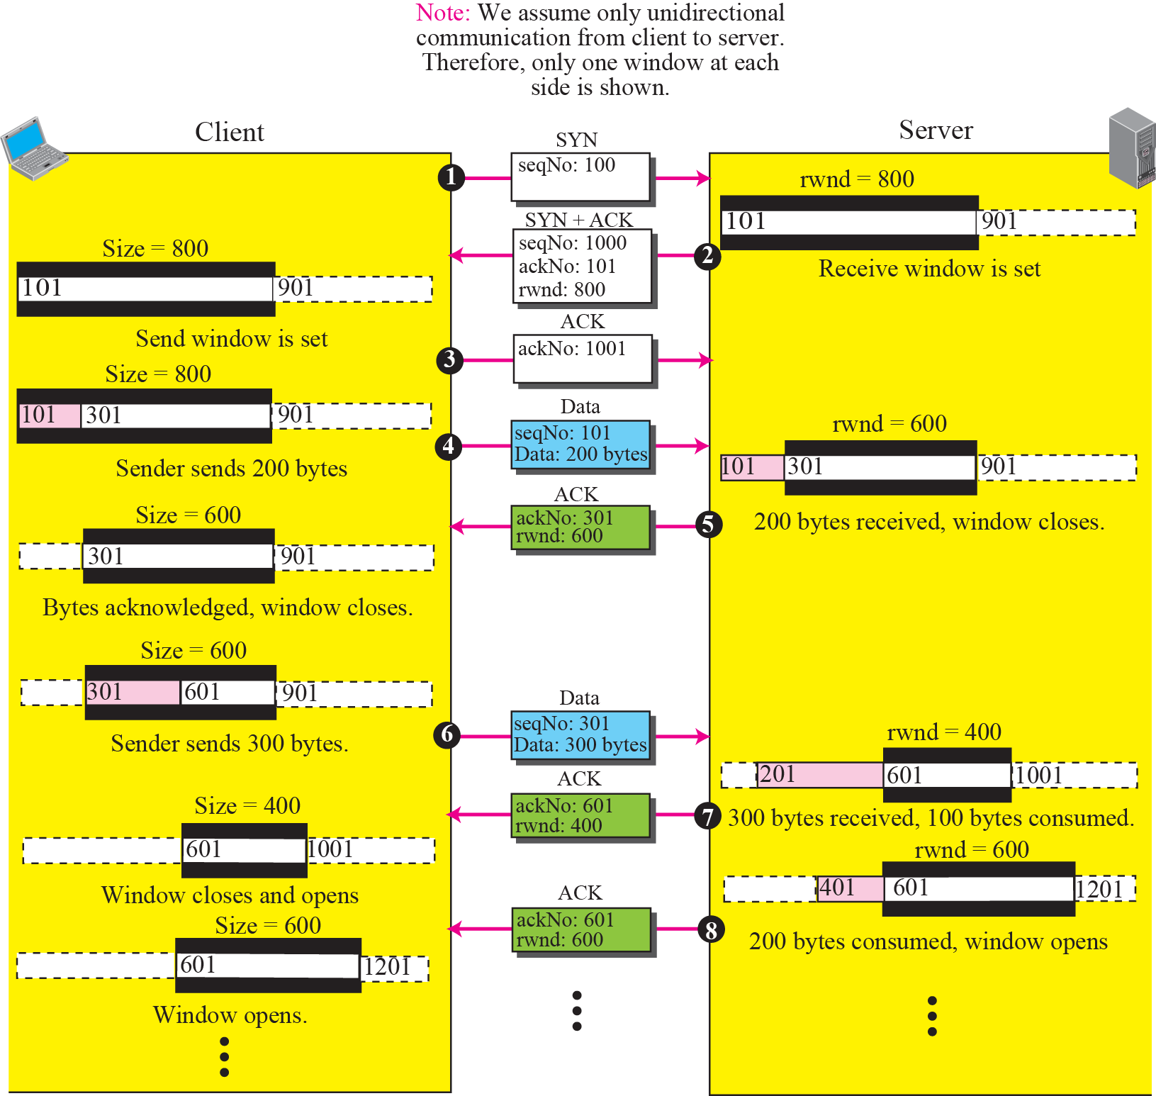
Normal Flow Control (Review)

Slide 24
TCP Window
Today, TCP protocols include that the sender’s window size is not only determined by the receiver but also by congestion in the network.
Windows Size of TCP
Minimum of rwnd and cwnd
Where rwnd is the receiver advertised window size
And cwnd is the networks congestion window size
Actual window size = minimum of (rwnd,cwnd)
The Congestion Window (cwnd) in TCP is a sender-side state variable
It dictates how much data can be transmitted before receiving an ACK, calculated as

Slide 25
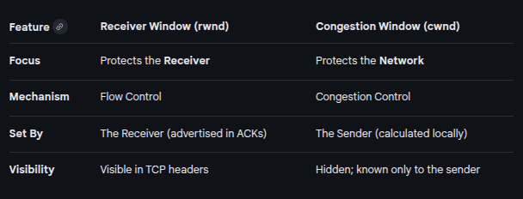
RWND and CWND

Slide 26
TCP congestion control
TCP does congestion control in three phases:
Slow Start
Congestion Avoidance
Congestion Detection

Slide 27
TCP Congestion Principles
If we get the ACK of a sent Segment within the RTO,
means the network is not congested.
So, we send data at a higher rate, i.e (increase the CWND)

Slide 28
TCP Congestion Principles
Lost Segment indicates Congestion
Lost Segment can be identified in two ways
Time out (Major congestion)
3 Duplicate ACK (Minor Congestion)
What happens after Congestion is detected ?
Send data at a lower rate i.e (reduce the CWND)

Slide 29
TCP Congestion Overall Strategy
Increase Transmission rate in response to arriving ACKs until a loss event occurs
If loss event occurs, decrease the transmission rate.

Slide 30
Slow Start
cwnd starts with one maximum segment size(MSS).
MSS determined during connection establishment.
MSS increases exponentially after each acknowledgement.
TCP Maximum Segment Size (MSS) defines the largest amount of data, in bytes, that a device can receive in a single TCP segment, excluding the TCP and IP headers
It is negotiated during the TCP three-way handshake (SYN packets) to ensure data fits within the network's Maximum Transmission Unit (MTU)

Slide 31
Slow Start- Exponential Increase
Assumptions:
rwnd>cwnd , so sender window=cwnd
Each segment is acknowledged individually.
In the slow-start algorithm, the size of the congestion window increases exponentially until it reaches a threshold.

Slide 32
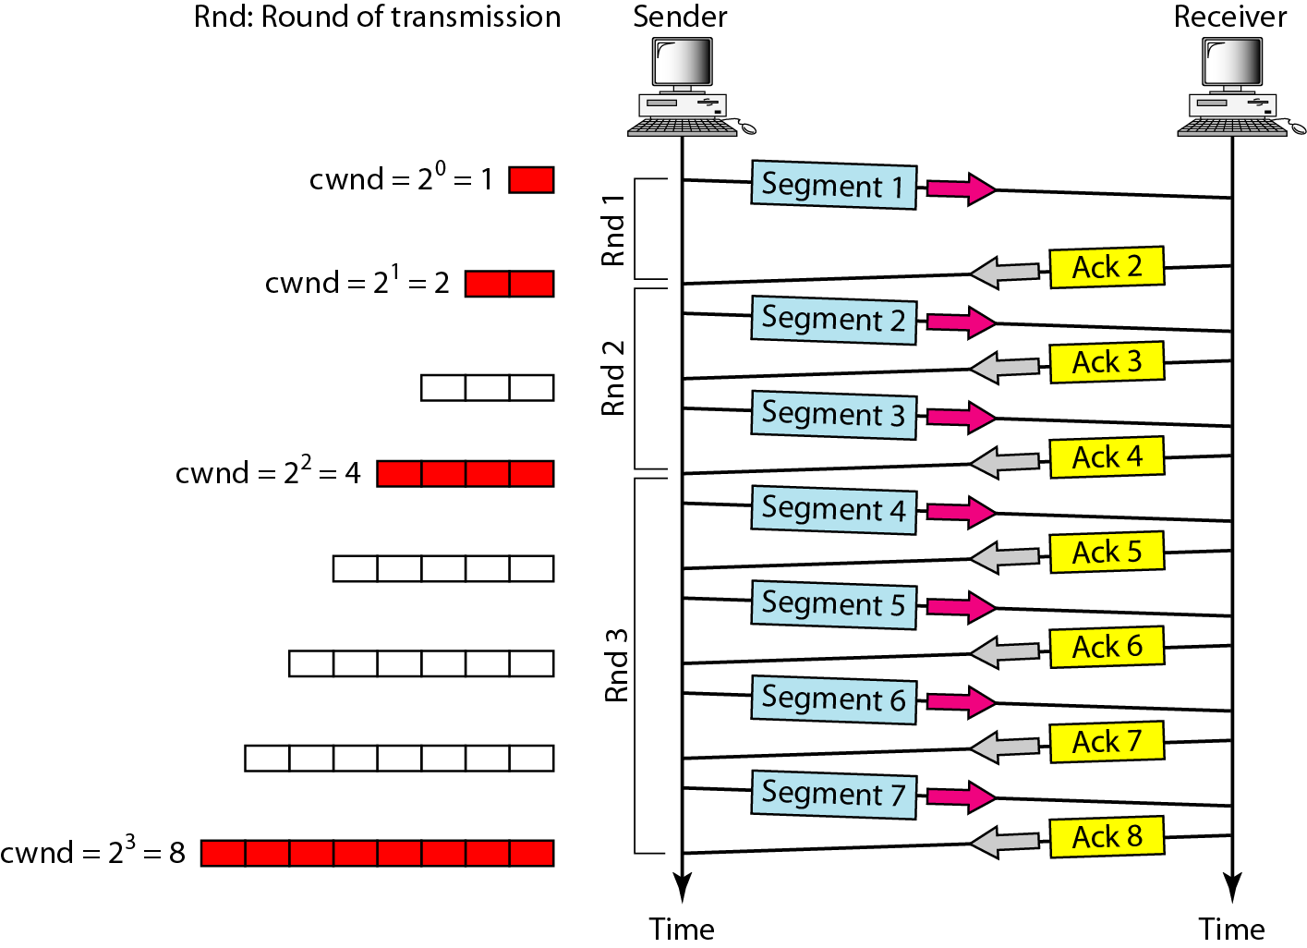
Slow Start- Exponential Increase
Assumptions:
each segment is of the same size
carries MSS bytes.
Ignore the delayed-ACK policy
each segment is acknowledged individually.
In TCP congestion control:
A round = sending all segments allowed by cwnd.

Slide 33
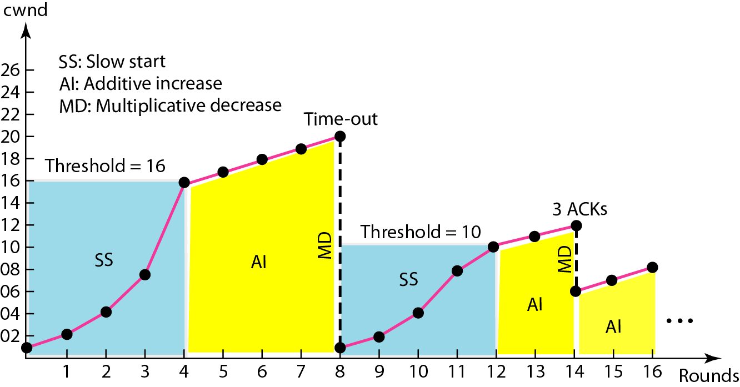
Slow Start
Sender keeps track of a variable named ssthresh.
When window reaches ssthresh the next phase starts.
Most implementation ssthresh is 65,535 bytes.

Slide 34
Congestion Avoidance:
In the congestion avoidance algorithm, the size of the congestion window increases additively until congestion is detected.

Slide 35
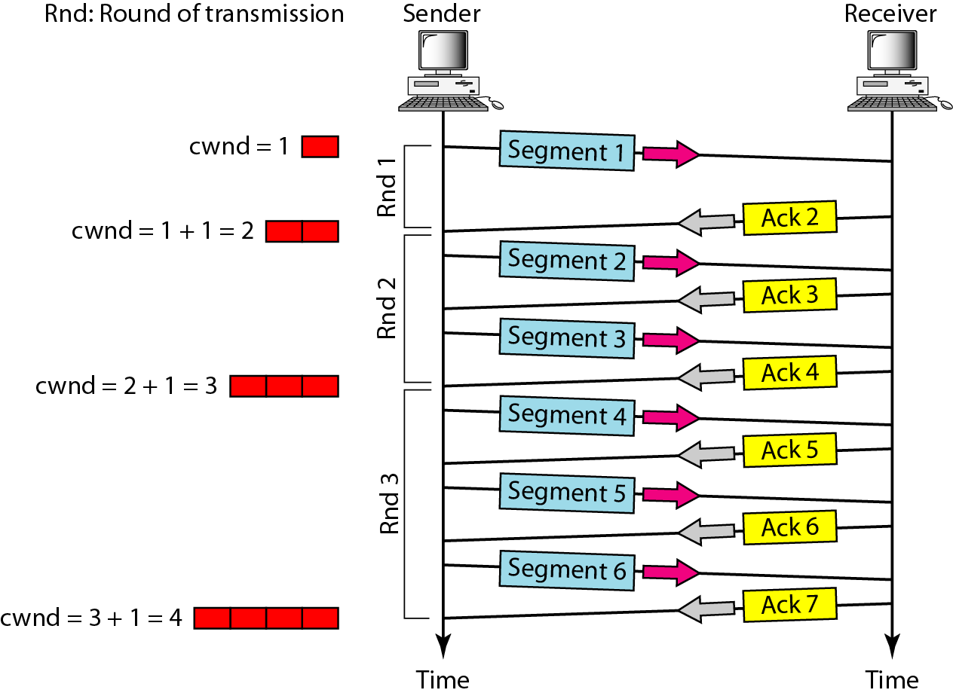
Congestion Avoidance:

Slide 36
Congestion Avoidance
In the CA phase we also increase the CWND. This may lead to congestion in the network. This leads us to congestion Detection phase. Congestion Detection have two categories:
Detection by Time-out
Detection by 3-Duplicate ACKs

Slide 37
Congestion Detection:
❏ If Time-out, a new slow start phase starts.
❏ If detection is by three ACKs, a new congestion avoidance phase starts.

Slide 38
Congestion Detection:
Congestion detected by time-out (severe congestion)
starts new slow start phase
ssthresh = max(2, floor(cwnd/2))
cwnd=1
Congestion detected by three ACKs (less severe congestion)
starts new congestion avoidance phase
ssthresh = max(2, floor(cwnd/2))
cwnd= ssthresh

Slide 39
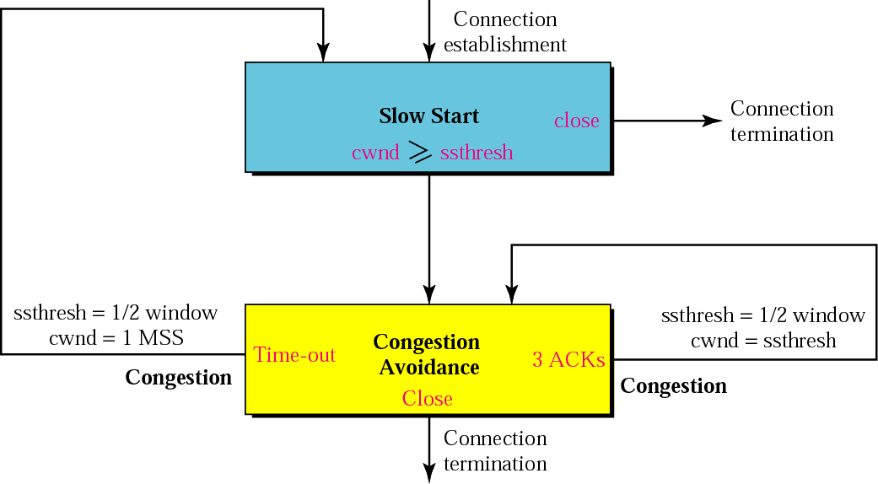
TCP Congestion Policy:

Slide 40
TCP Congestion Example:

Slide 41
The End

